Slide 1
WCNPO Striped Marlin Rebuilding Scenarios 2025 Projection Scenarios for CMM 24-06
ISC Billfish Working Group
Jon Brodziak
Jon.Brodziak@NOAA.GOV
22-April-2025

Slide 2
Open Science with Documentation and Reproducibility for the ISC Billfish Working Group
This presentation (NAME.pptx) is on the BILLWG google drive at: https://drive.google.com/drive/folders/1vNBZWGnTDX9_wl-RByhKqA40jsHUOJCy
To access the projection methods and results, clone or download the GitHub repository:
https://github.com/PIFSCstockassessments/2024-WCNPO-MLS-Rebuilding
Base case projection input files (3-recruitment models with 2-year out-of-sample weights) are in 2024-WCNPO-MLS-Rebuilding/2024 Results/base-runs

Slide 3
Rebuilding Target

Slide 4
CMM 2024-06 Revision to CMM 2010-01 for NP MLS
Country | Catch Limit
Japan | 1454.4mt
Chinese Taipei | 358.4mt
Korea | 214.8mt
United States | 228.4mt
China | 68.8 mt
Other SIDS | 75.2 mt
Total | 2400 mt
Maximum catch limit of 2400 mt
In 2025-2027, each country can take up to 165 mt additional to their individual limit if the catch limit in 2023-2025 is not reached
In 2023 there was an underage of 826 mt therefore countries are allowed to increase their limit by 165 mt in 2025.
Any underage in 2024 can be applied to 2026, and 2025 to 2027.
No country is allowed to increase their catch by more than 165 mt.
If underage is less than 826 mt, then there will be decisions made about who gets that extra catch (not our problem)
Overage for each country is subtracted from their next year’s individual limit

Slide 5
Scenario 1. Set CMM 2024-06 Catch Limits at 2,400 mt
Country | 2025 | 2026 | 2027
Japan | 1454.4 mt | 1454.4 mt | 1454.4 mt
Chinese Taipei | 358.4 mt | 358.4 mt | 358.4 mt
Korea | 214.8 mt | 214.8 mt | 214.8 mt
United States | 228.4 mt | 228.4 mt | 228.4 mt
China | 68.8 mt | 68.8 mt | 68.8 mt
Other SIDS | 75.2 mt | 75.2 mt | 75.2 mt
Total | 2400 mt | 2400 mt | 2400 mt
For countries which are represented by more than one fleet in the rebuilding analysis, catch would be distributed between fleets based upon the proportion of catch for each fleet in 2020 (last year of the assessment)
For 2021-2022, catch would be updated to reported (yearbook catch) from WCPFC, and 2023-2024 would be carryover catch from 2022 if updated catch is not available.

Slide 6
Scenario 2. Set CMM 2024-06 Catch Limits with 2025 Carryover
Country | 2025 | 2026 | 2027
Japan | 1454.4 mt + 165 mt | 1454.4 mt | 1454.4 mt
Chinese Taipei | 358.4mt + 165 mt | 358.4 mt | 358.4 mt
Korea | 214.8mt + 165 mt | 214.8 mt | 214.8 mt
United States | 228.4mt + 165 mt | 228.4 mt | 228.4 mt
China | 68.8 mt + 165 mt | 68.8 mt | 68.8 mt
Other SIDS | 75.2 mt | 75.2 mt | 75.2 mt
Total | 3225 mt | 2400 mt | 2400 mt
For countries which are represented by more than one fleet in the rebuilding analysis, catch would be distributed between fleets based upon the proportion of catch for each fleet in 2020 (last year of the assessment)
For 2021-2022, catch would be updated to reported (yearbook catch) from WCPFC, and 2023-2024 would be carryover catch from 2022 if updated catch is not available.
.

Slide 7
Scenario 3. Set CMM 2024-06 Catch Limits and 2025-2026 Carryover
Country | 2025 | 2026 | 2027
Japan | 1454.4 mt + 165 mt | 1454.4 mt + 165 mt | 1454.4 mt
Chinese Taipei | 358.4 mt + 165 mt | 358.4 mt + 165 mt | 358.4 mt
Korea | 214.8 mt + 165 mt | 214.8 mt + 165 mt | 214.8 mt
United States | 228.4 mt + 165 mt | 228.4 mt + 165 mt | 228.4 mt
China | 68.8 mt + 165 mt | 68.8 mt + 165mt | 68.8 mt
Other SIDS | 75.2 mt | 75.2 mt | 75.2 mt
Total | 3225 mt | 3225 mt | 2400 mt
For countries which are represented by more than one fleet in the rebuilding analysis, catch would be distributed between fleets based upon the proportion of catch for each fleet in 2020 (last year of the assessment)
For 2021-2022, catch would be updated to reported (yearbook catch) from WCPFC, and 2023-2024 would be carryover catch from 2022 if updated catch is not available.

Slide 8
Apportion MLS Catch to Fleet Groups from the 2023 Assessment

Slide 9
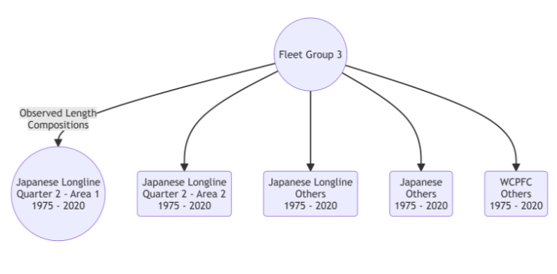
Japanese Longline Quarter 2 – Area 1 Fleet Group 3

Slide 10
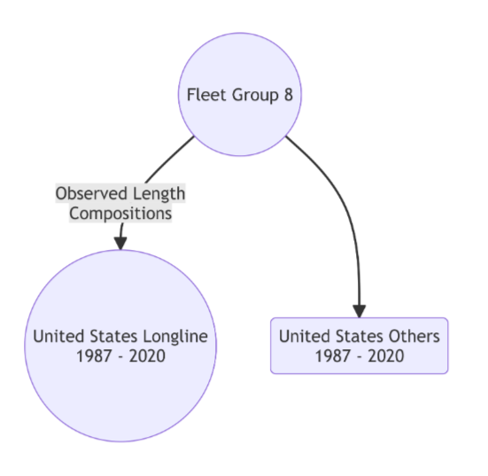
Hawaii Longline Fleet Group 8

Slide 11
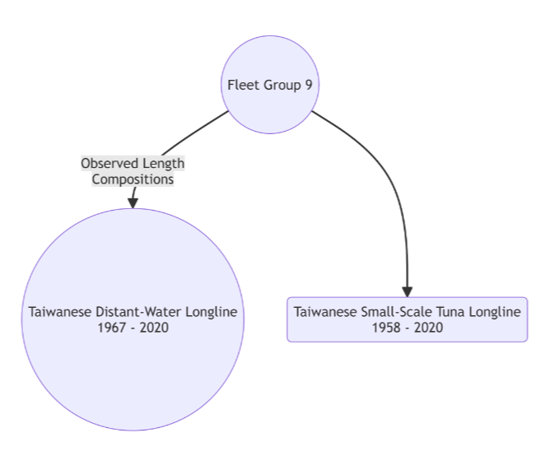
Taiwanese Longline Fleet Group 9

Slide 12
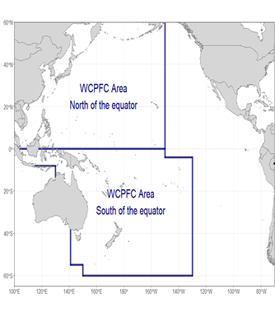
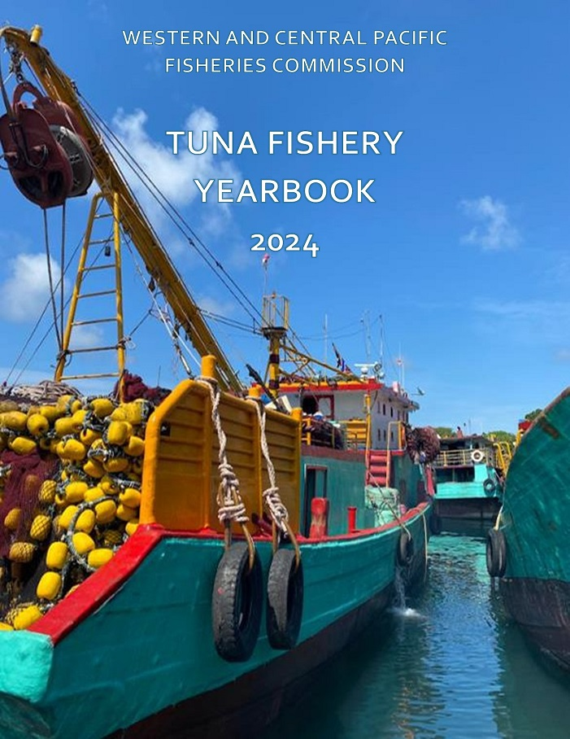
Gather 2021-2023 MLS Catches in the WCPFC Area North of the Equator from the WCPFC Yearbook

Slide 13
WCPFC Yearbook Reported MLS Catches with Imputed 2024 Catch
Data from XLS_NorthWCPFC.csv

Slide 14
WCPFC Yearbook Reported MLS Catch with Imputed 2024 Catch
Data from XLS_NorthWCPFC.csv

Slide 15
Reported MLS Catch from Japan
Data from ISC Billfish Working Group

Slide 16
Reported MLS Catch from Japan

Slide 17
Reported MLS Catch from the United States
Data from ISC Billfish Working Group

Slide 18
Reported MLS Catch from the United States

Slide 19
Initial Catches are Lower for the 2025 Projection Scenarios

Slide 20
Initial Fishing Mortalities are Lower for the 2025 Projection Scenarios

Slide 21
MLS Year Classes in 2018-2020 Were Above Short-Term Average

Slide 22
MLS Catches in 2021-2023 Were the Lowest Observed Since 1977

Slide 23
What is the Abundance of the 2020 Year Class ?

Slide 24
What is the Abundance of the 2020 Year Class ?

Slide 25
Apportion Projected Taiwanese Catch in 2025-2027 to Fleet Groups

Slide 26
Apportion Projected Japanese Catch in 2025-2027 to Fleet Groups

Slide 28
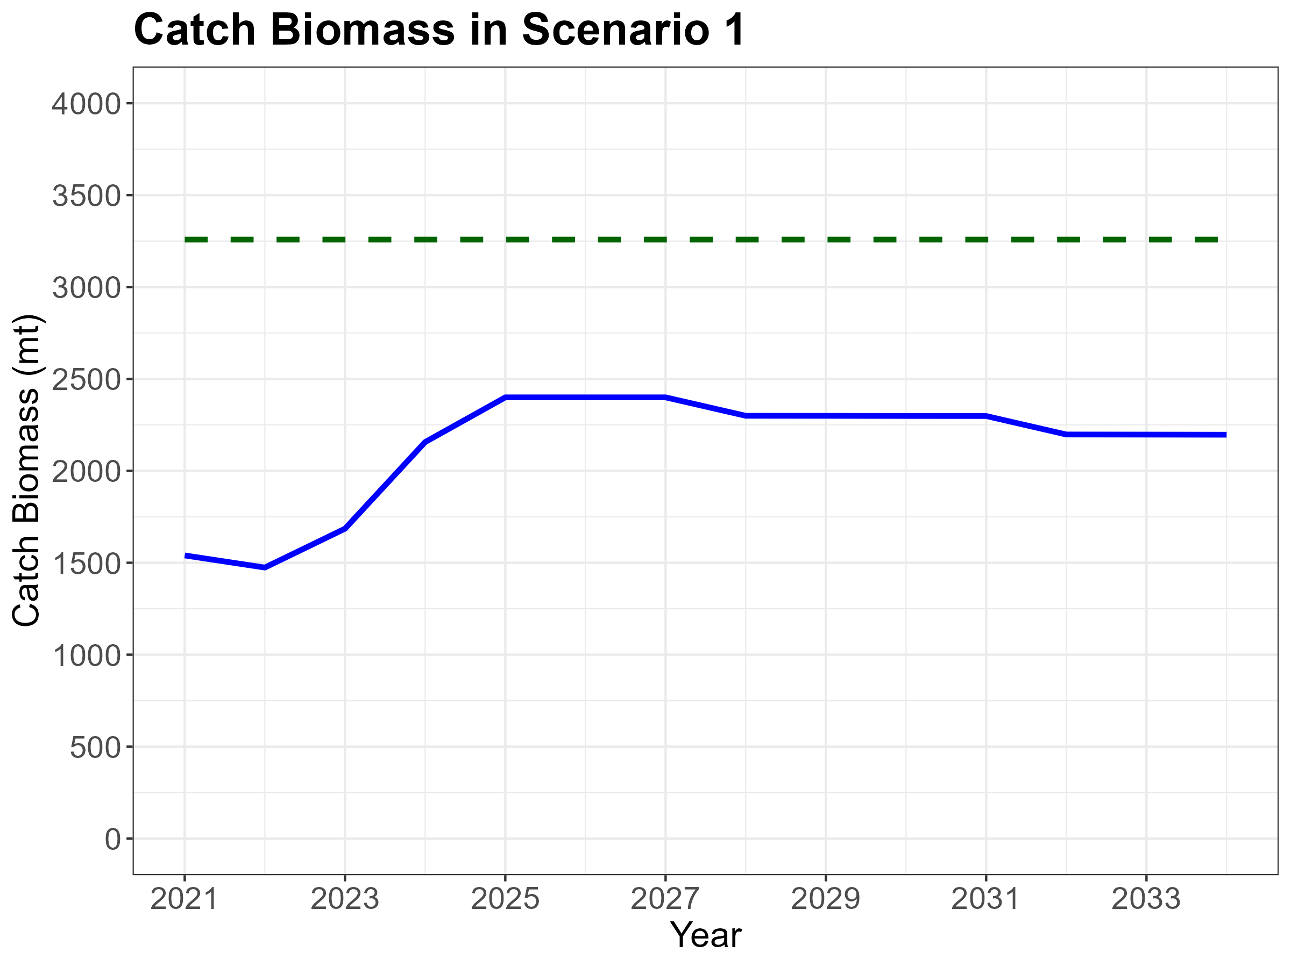

Slide 29
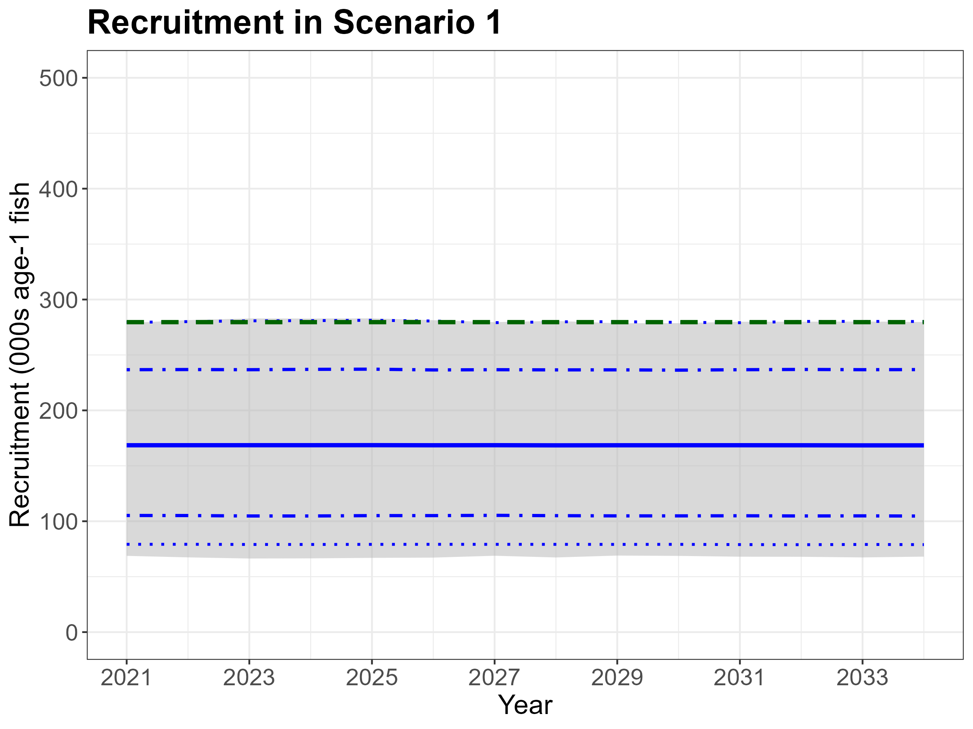

Slide 30
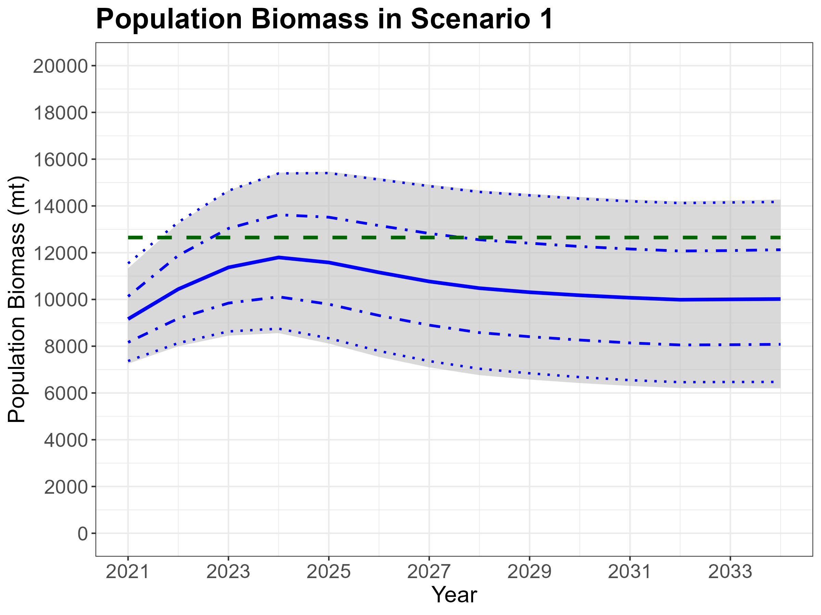

Slide 31
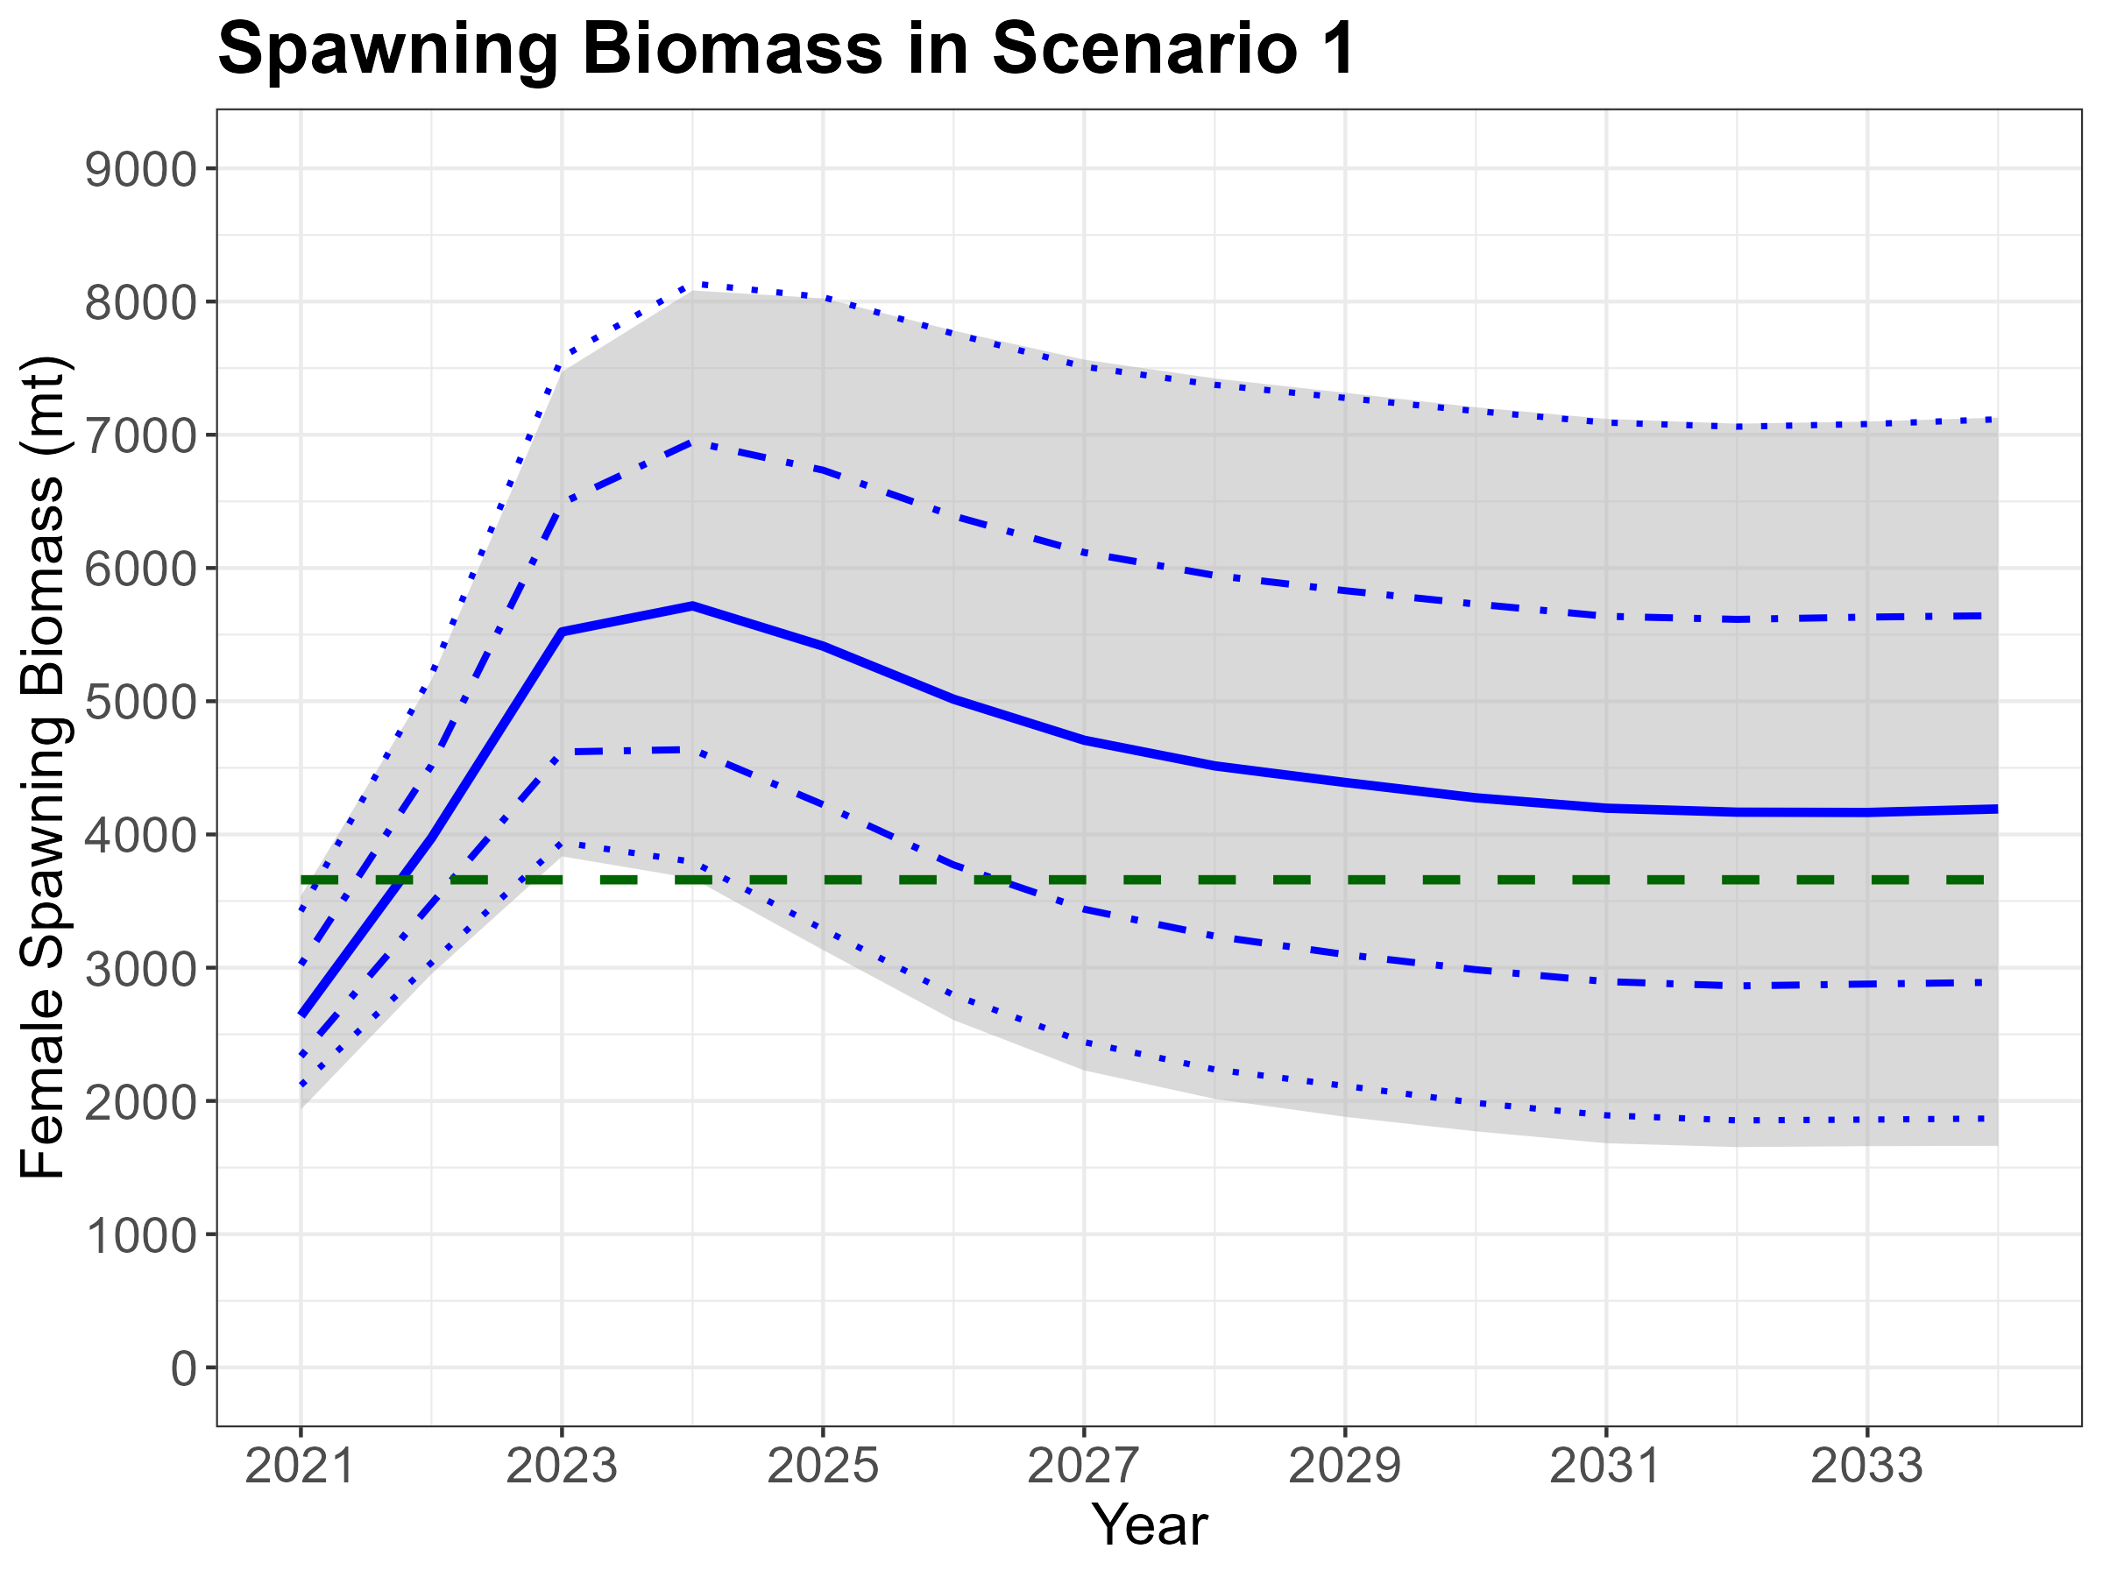

Slide 32
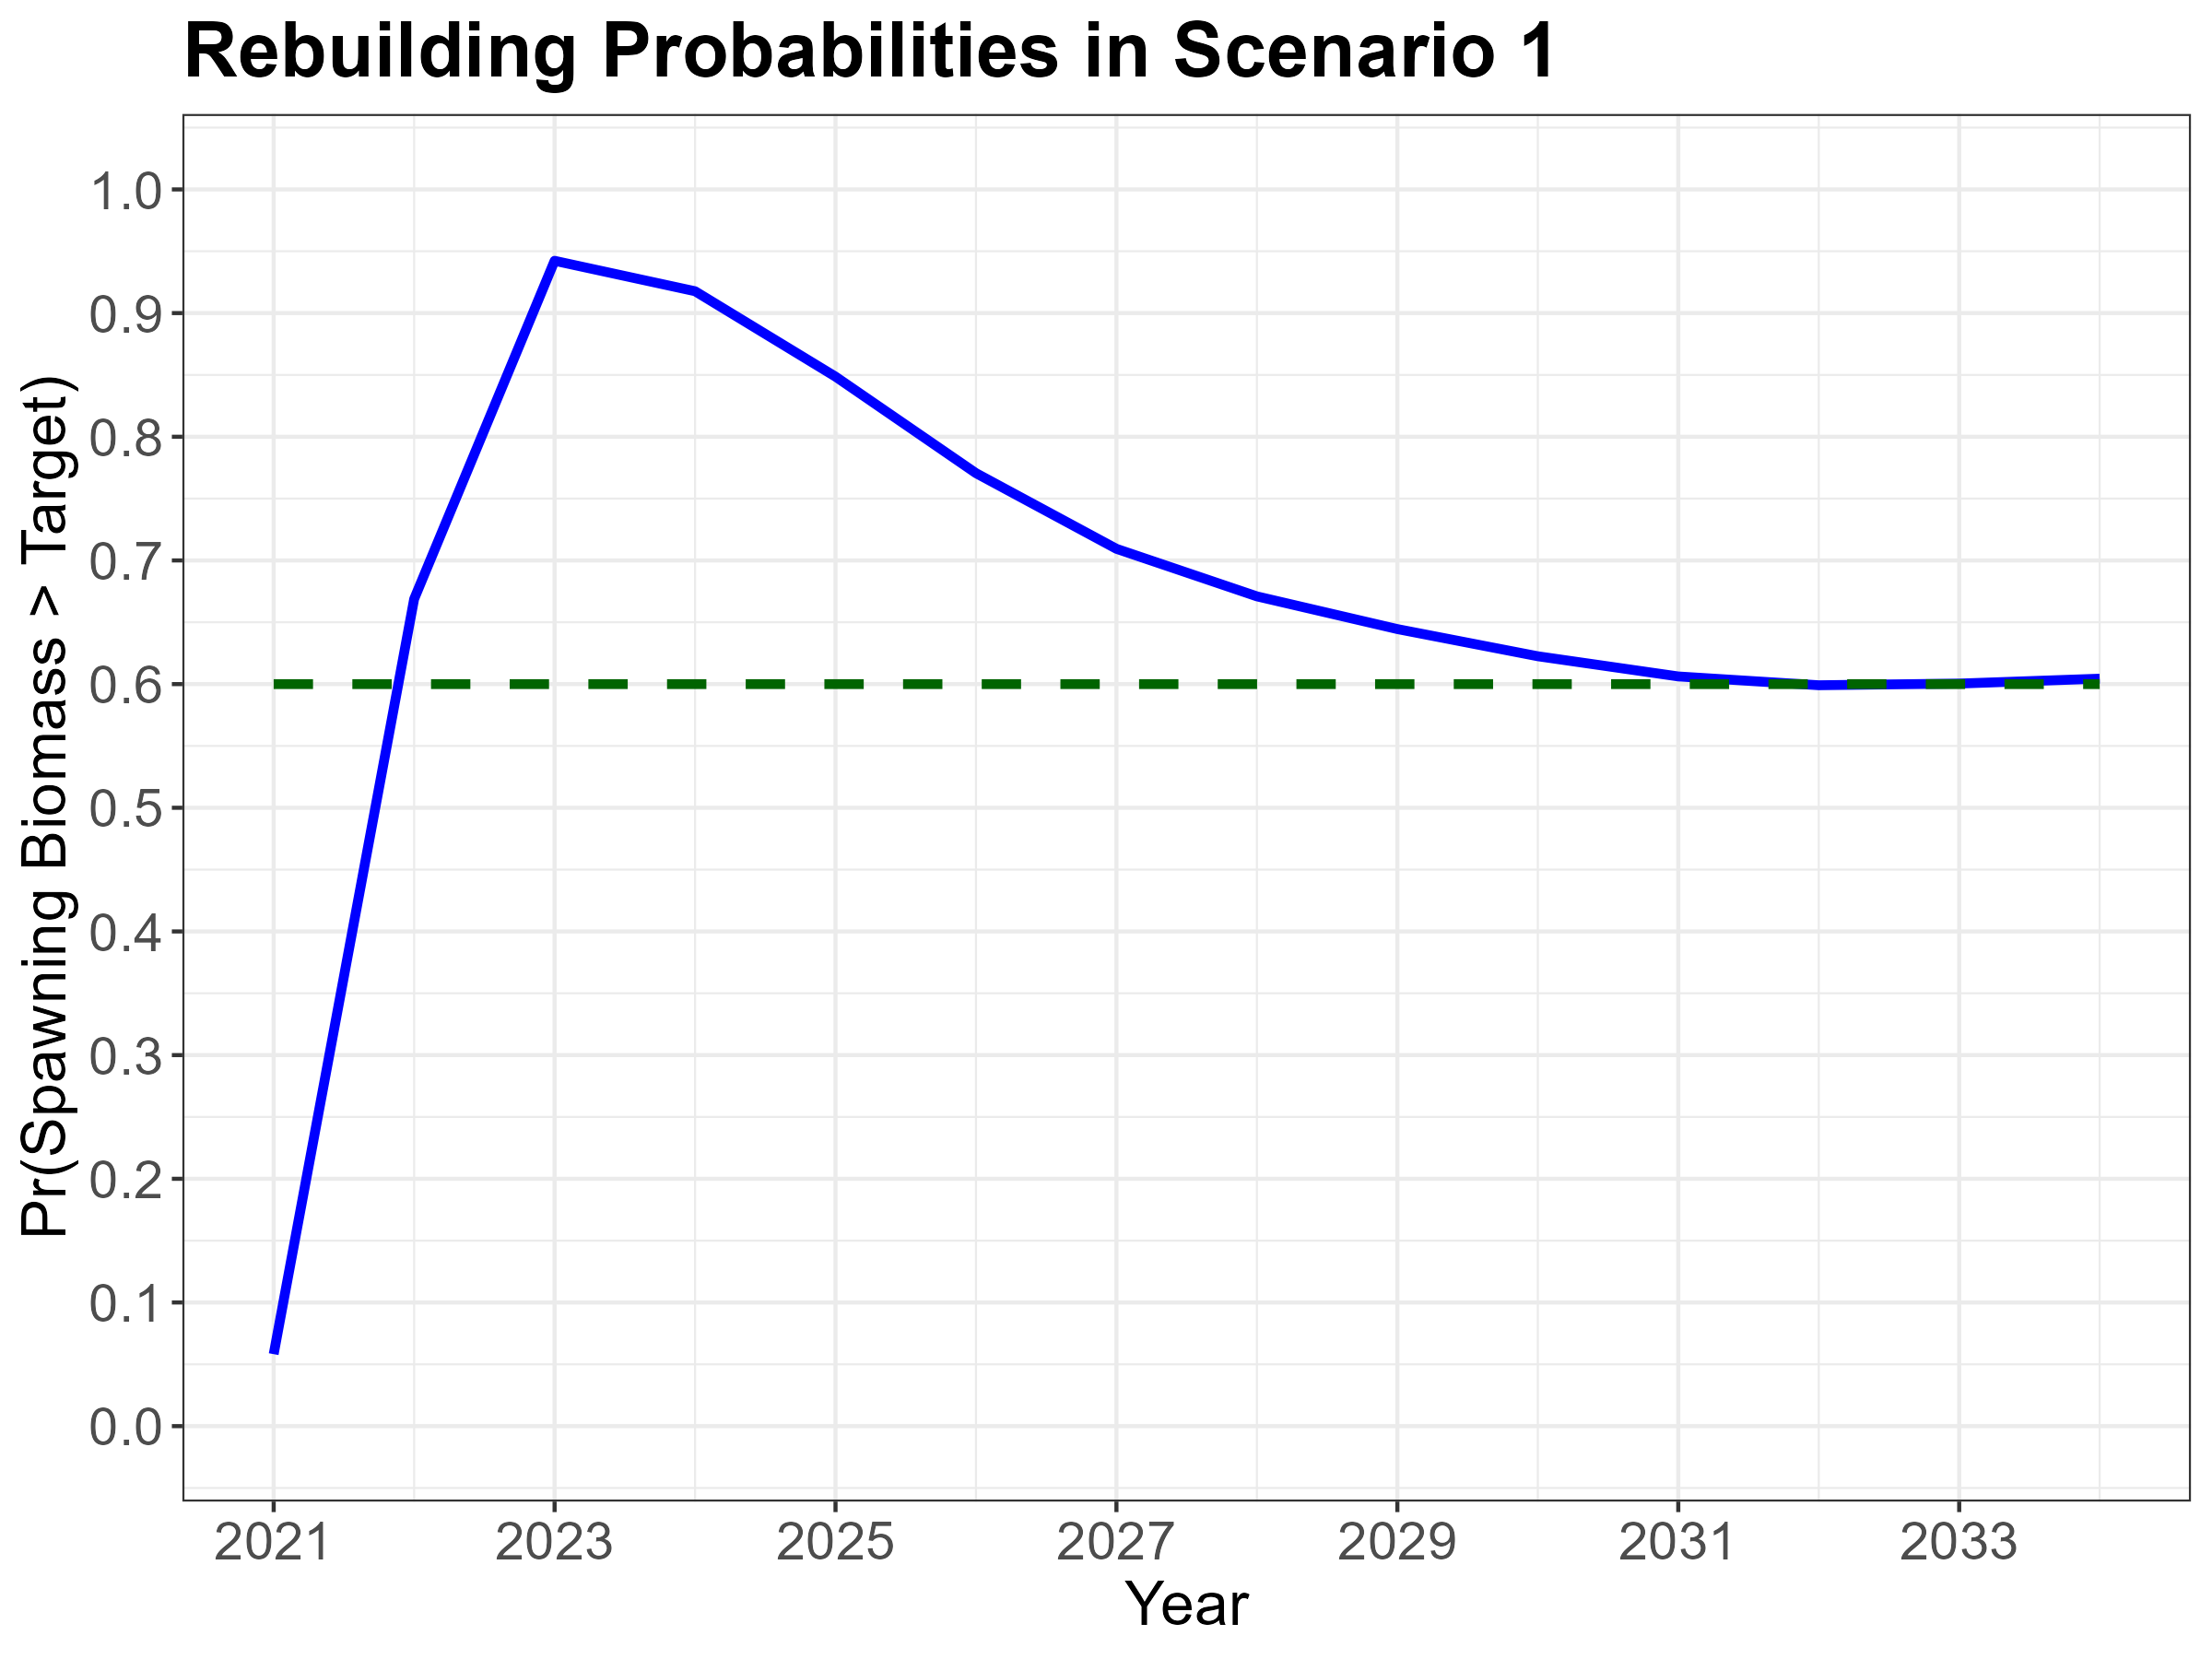

Slide 33
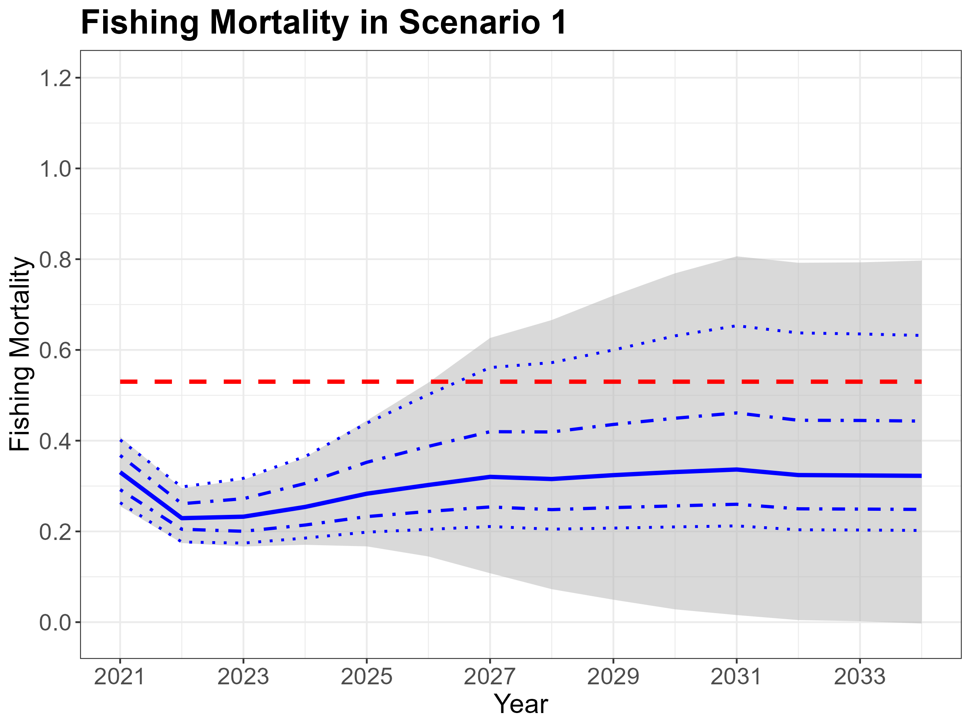

Slide 34
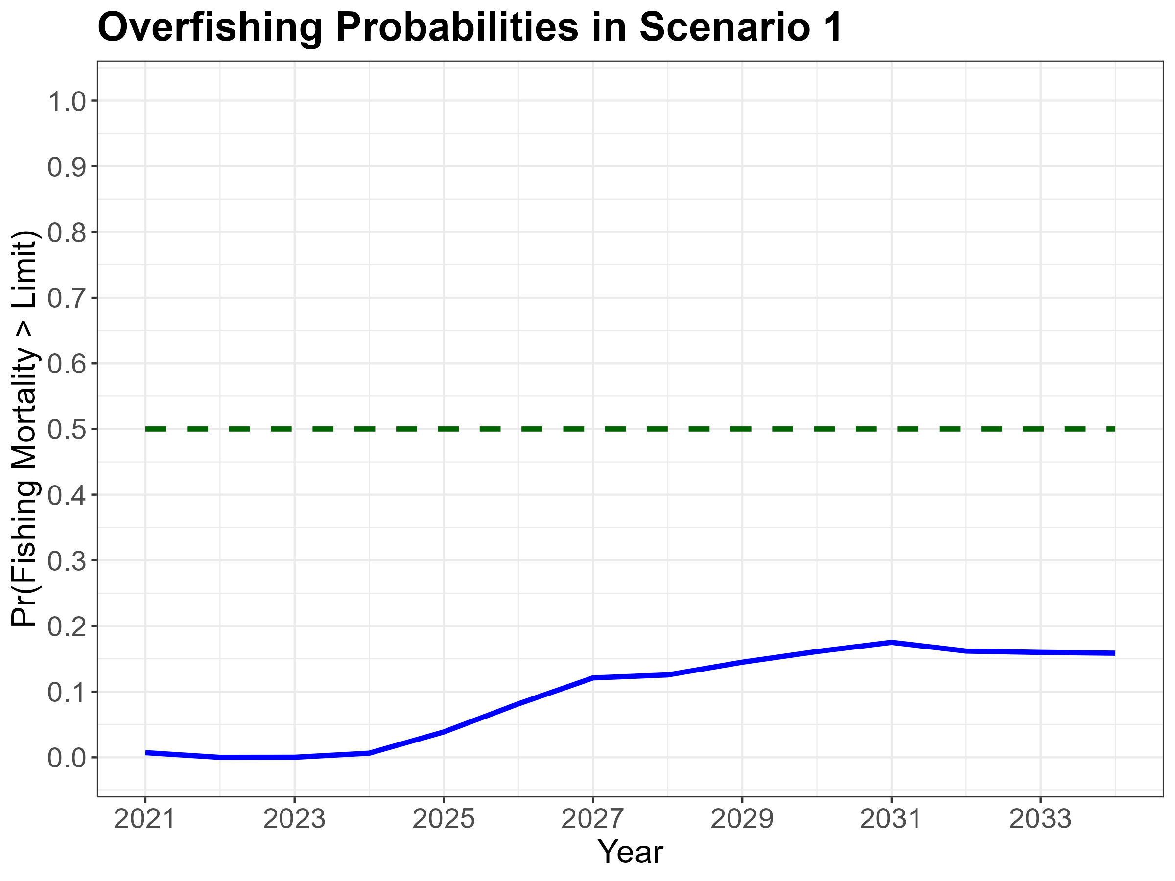

Slide 36
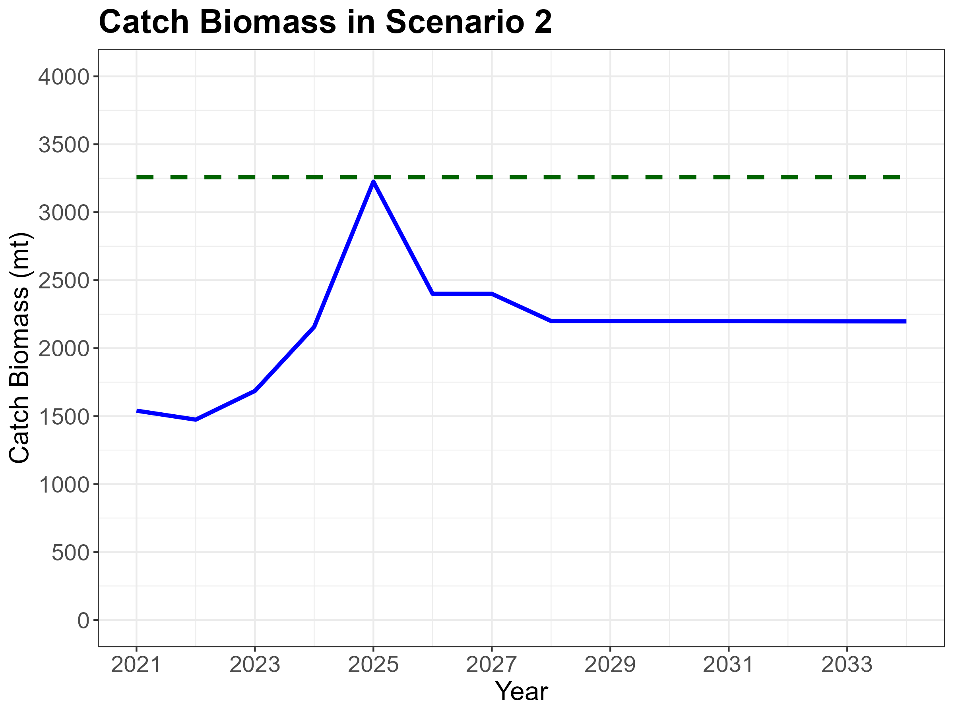

Slide 37
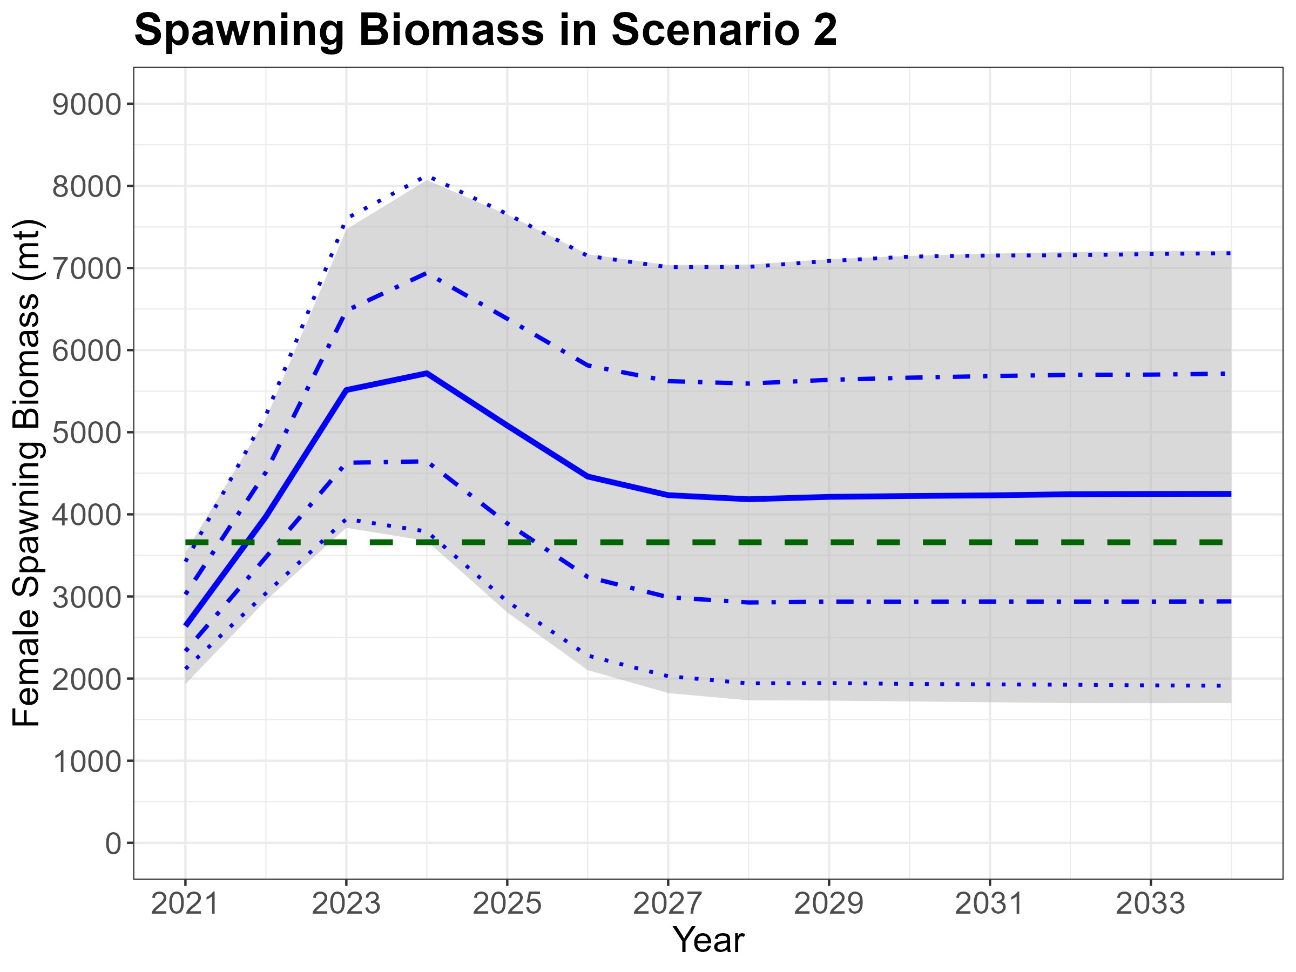

Slide 38
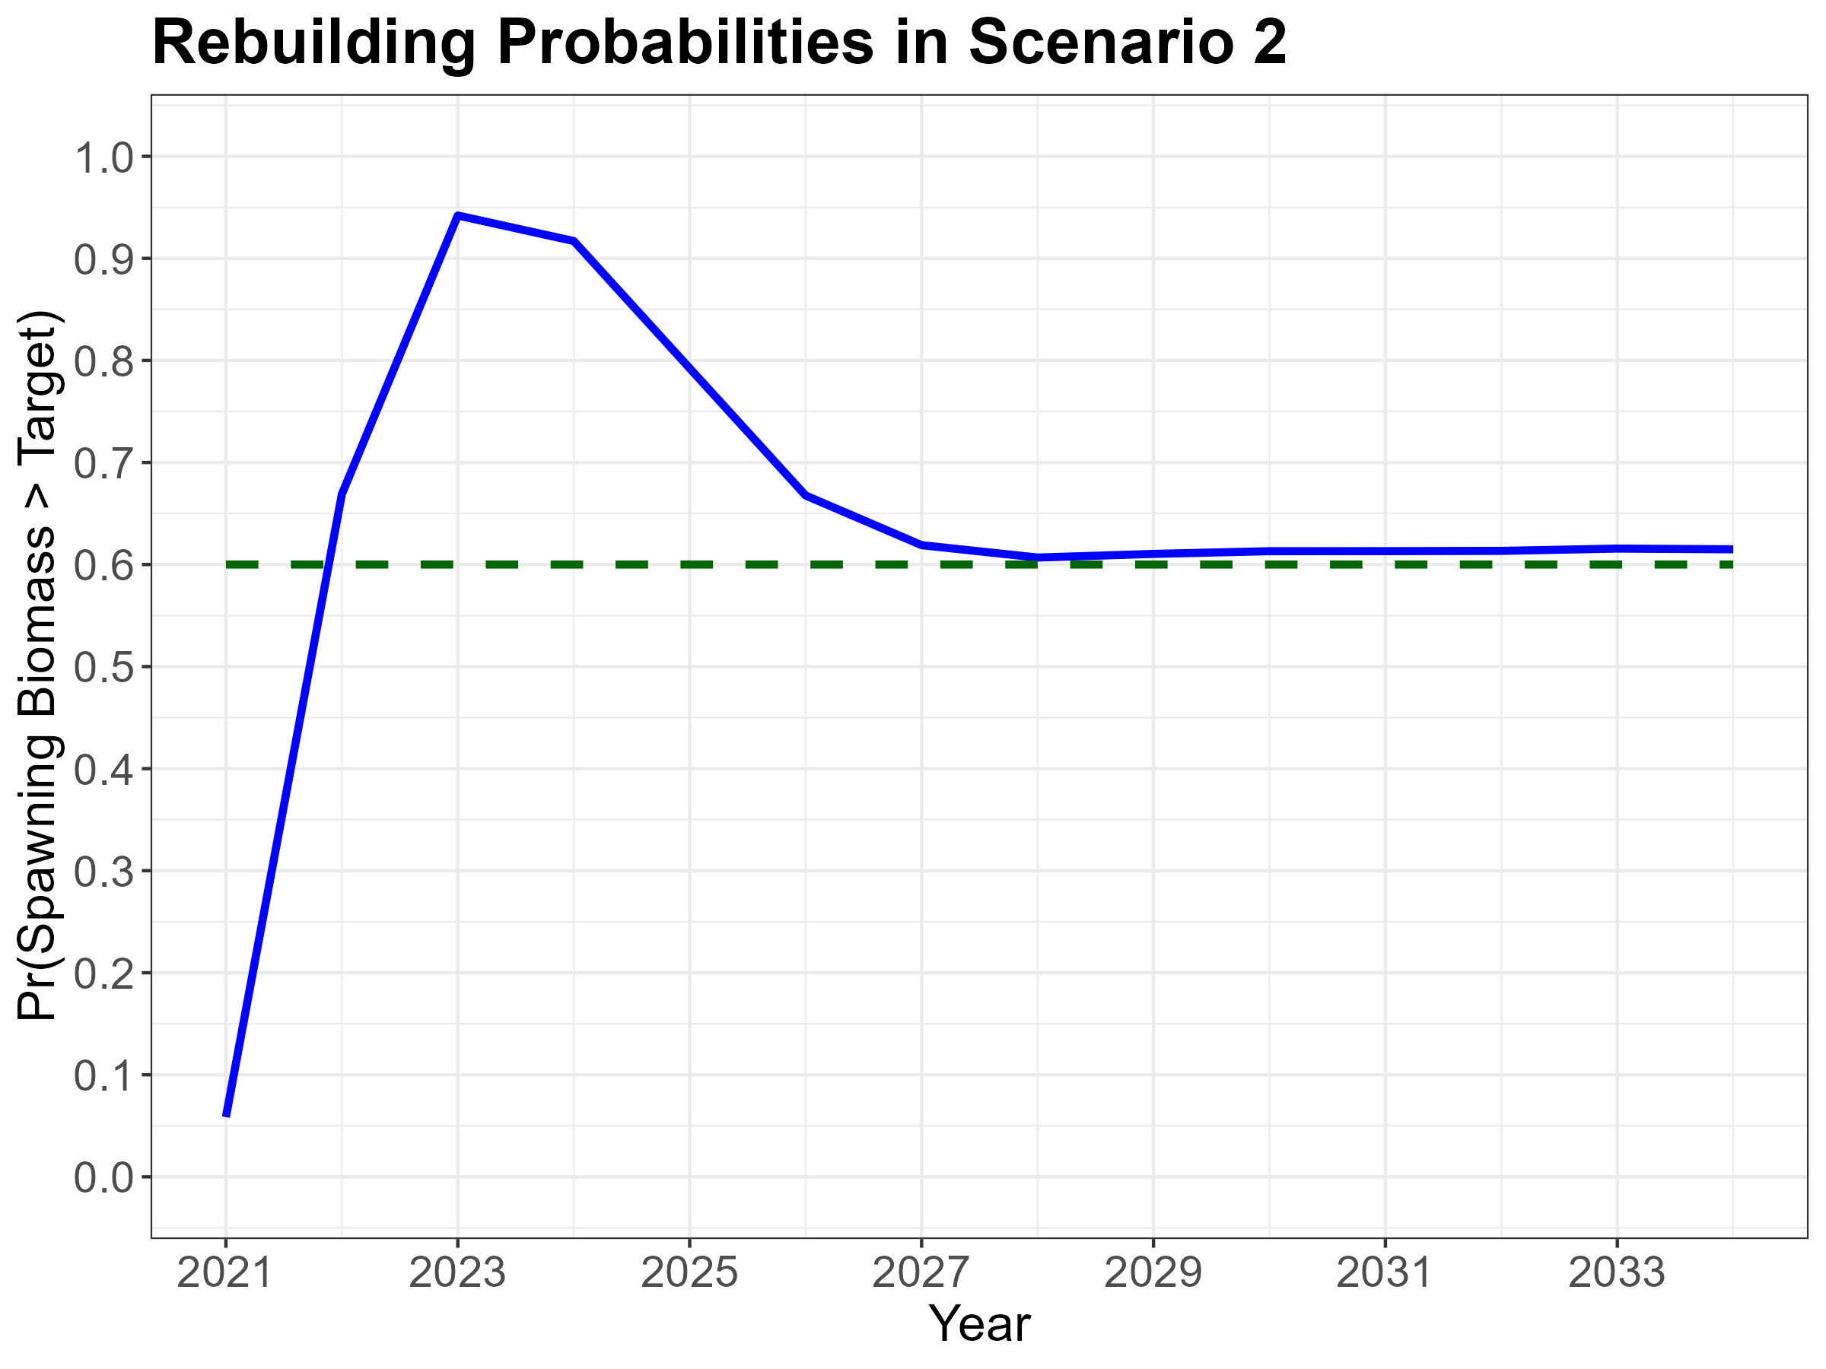

Slide 39
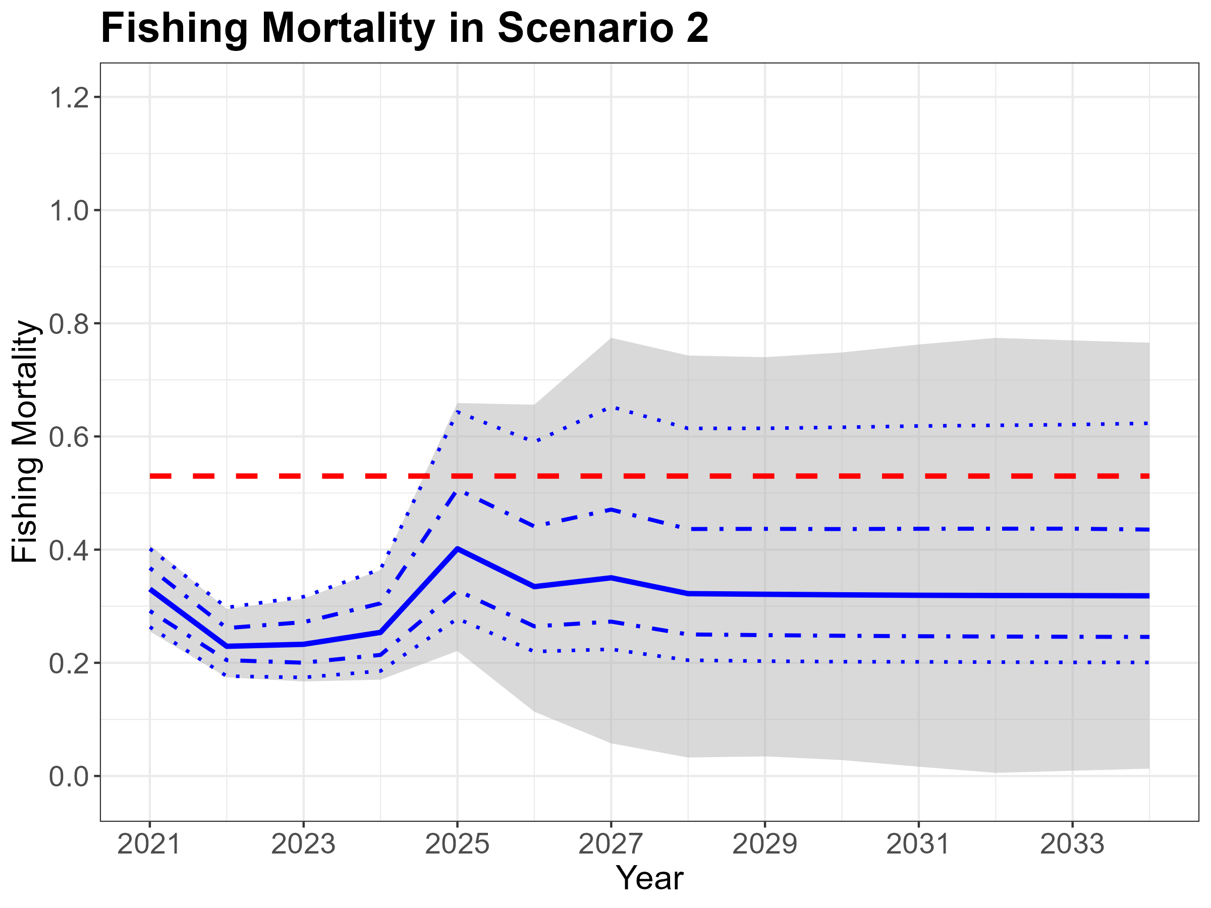

Slide 40
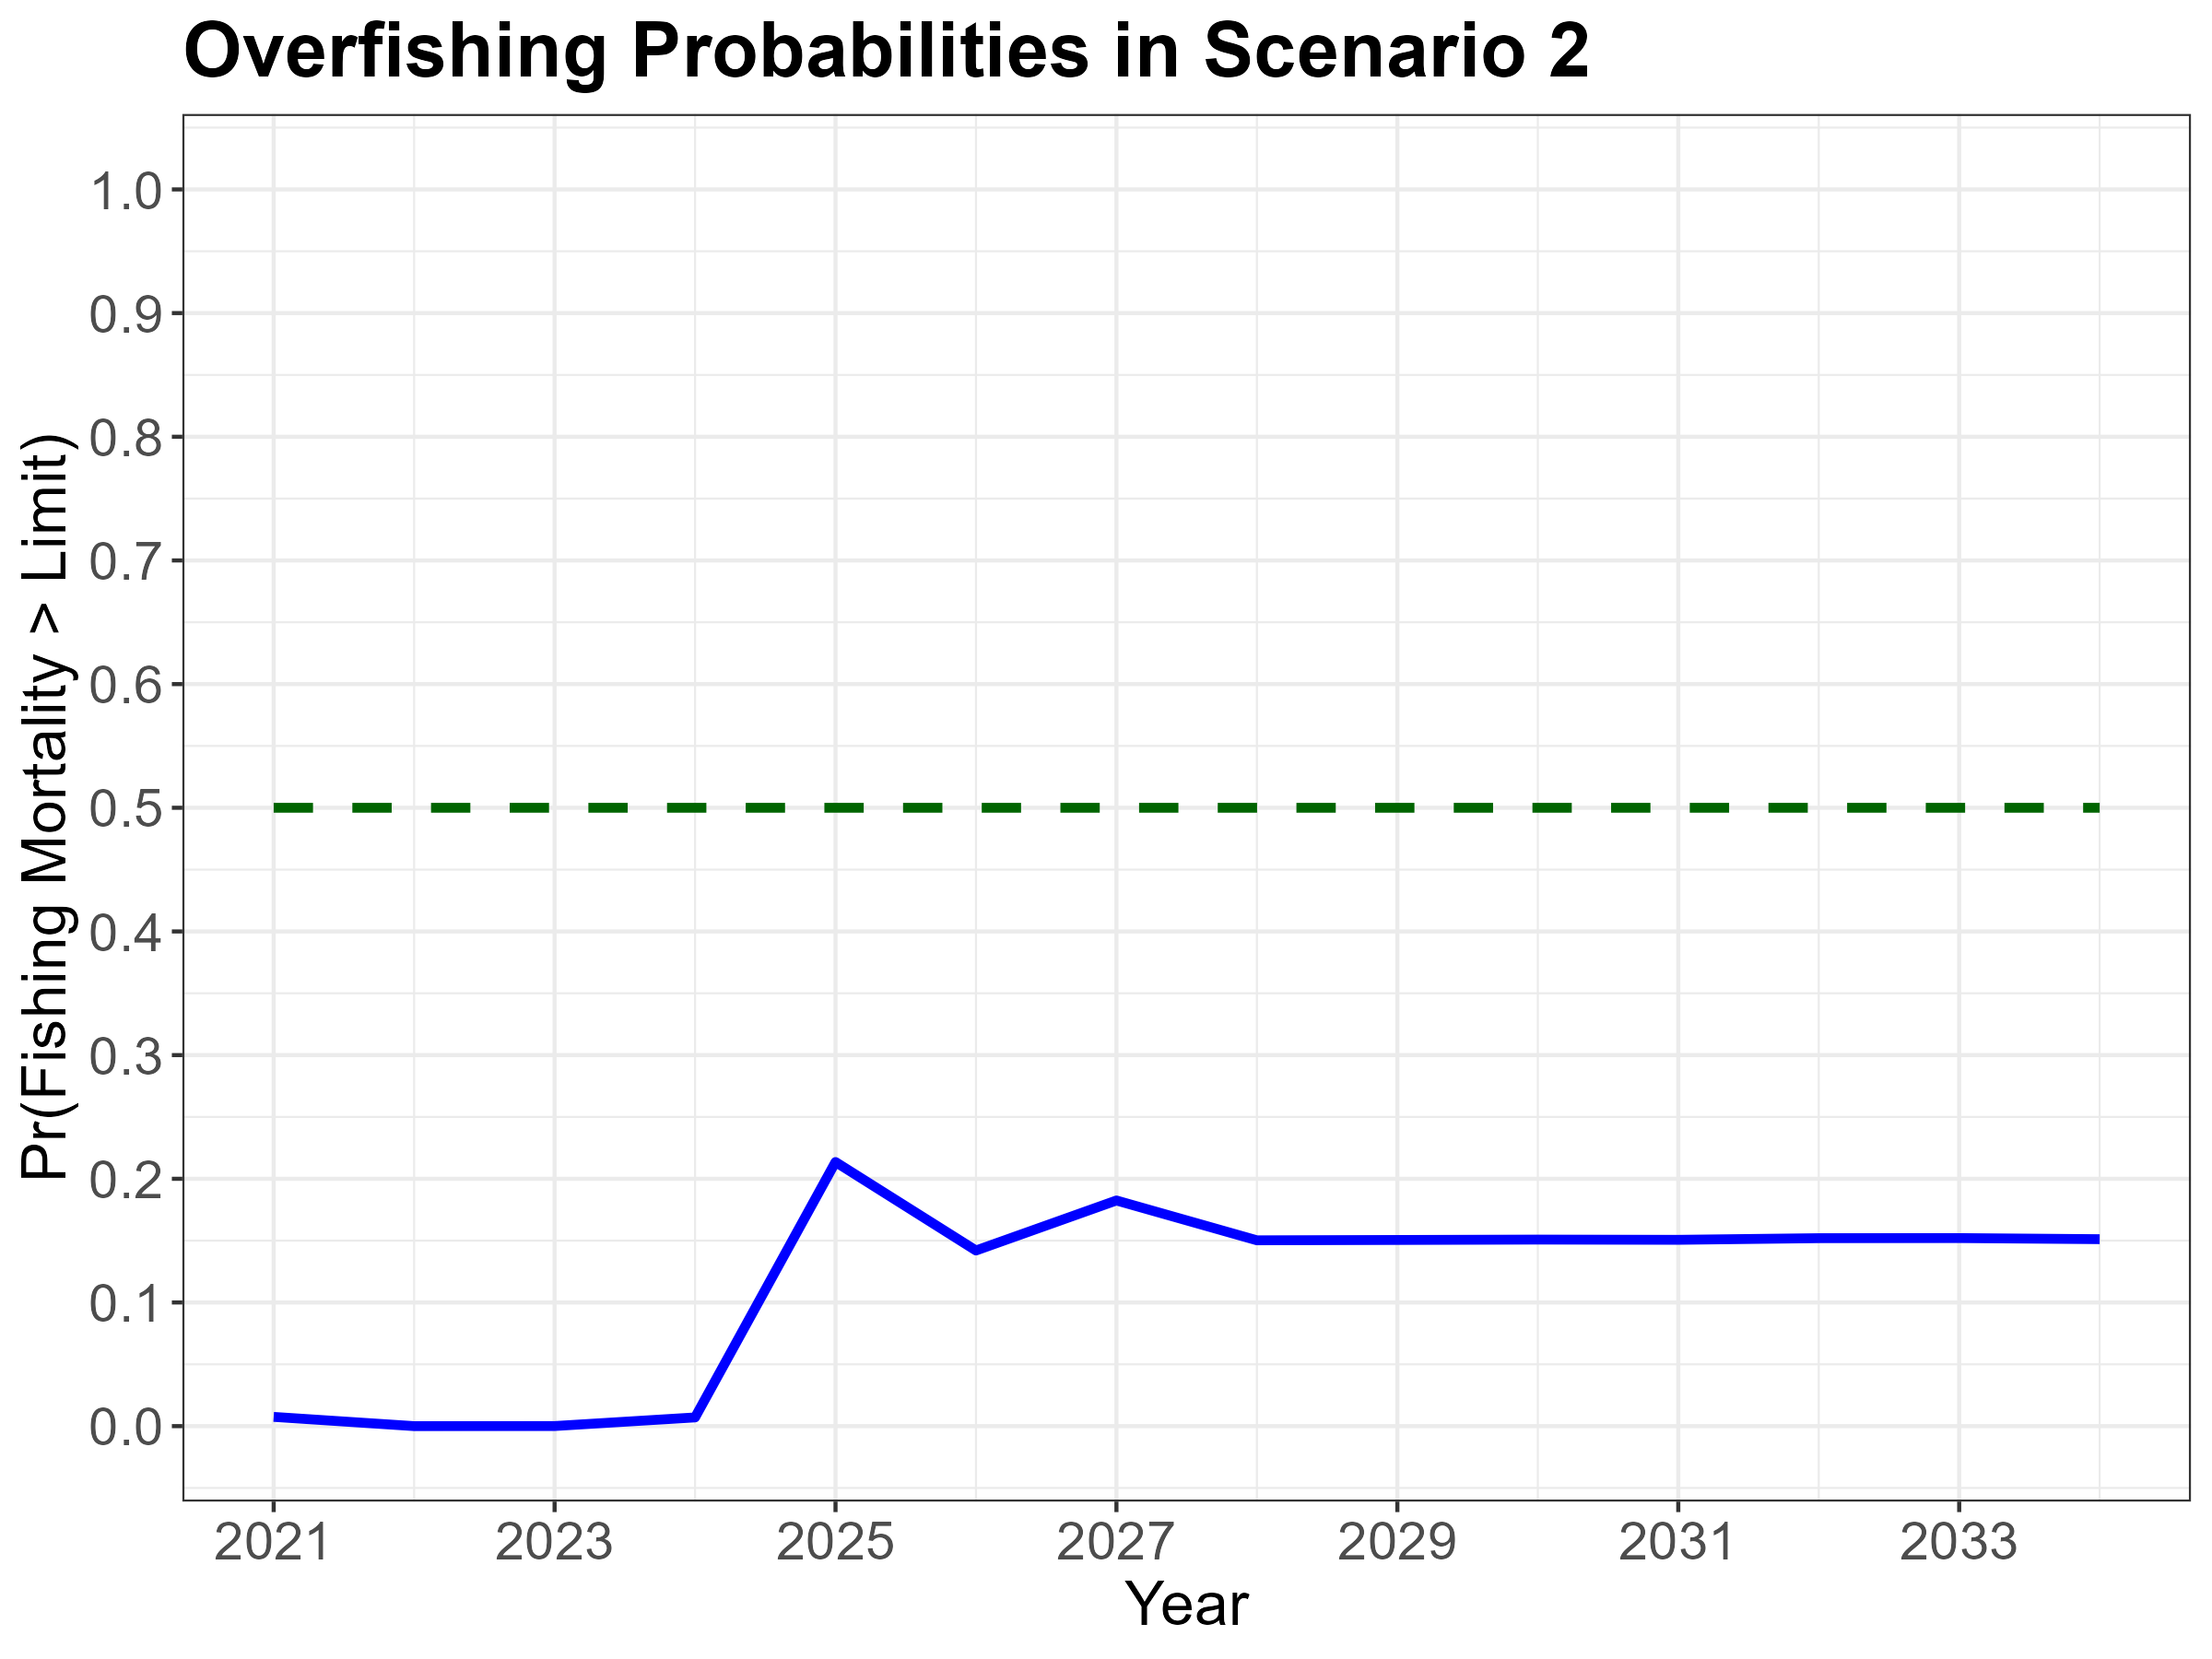

Slide 42
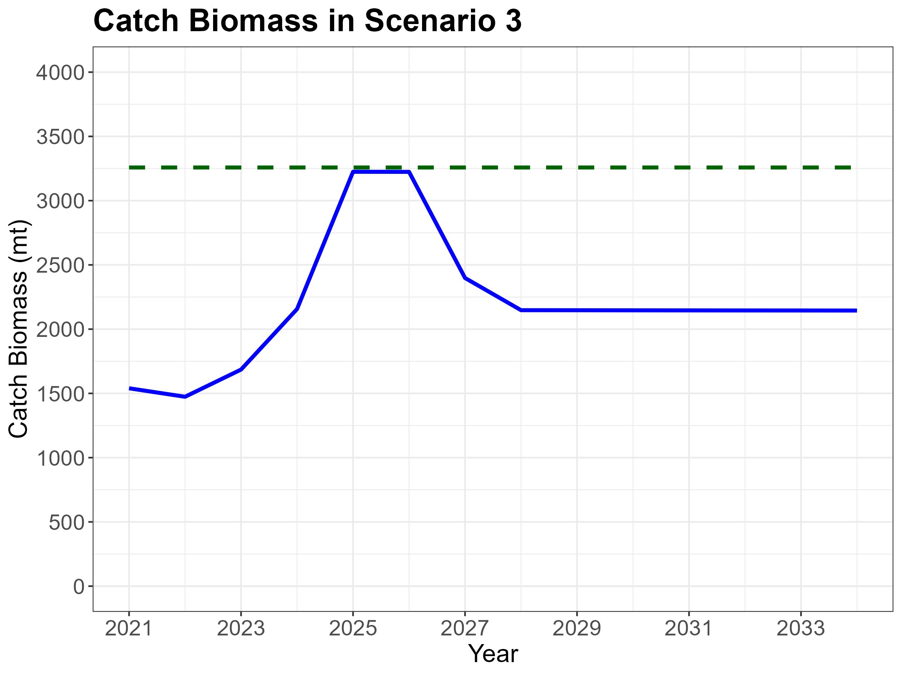

Slide 43
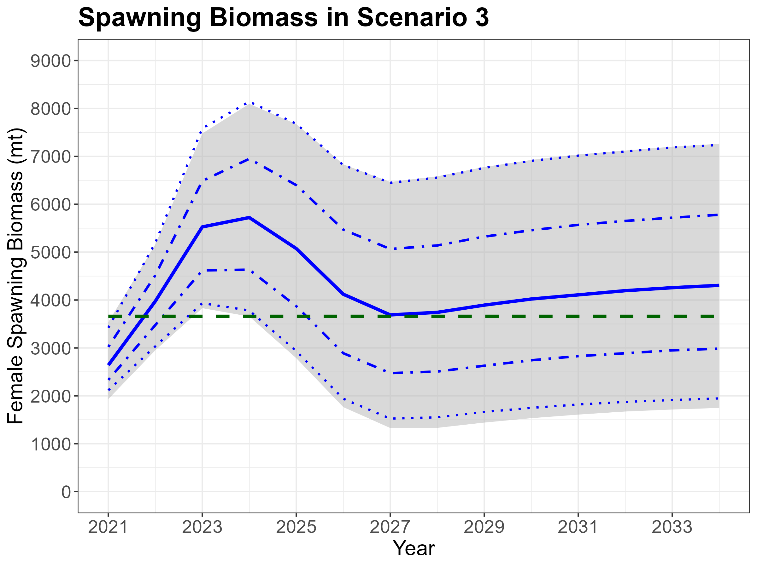

Slide 44
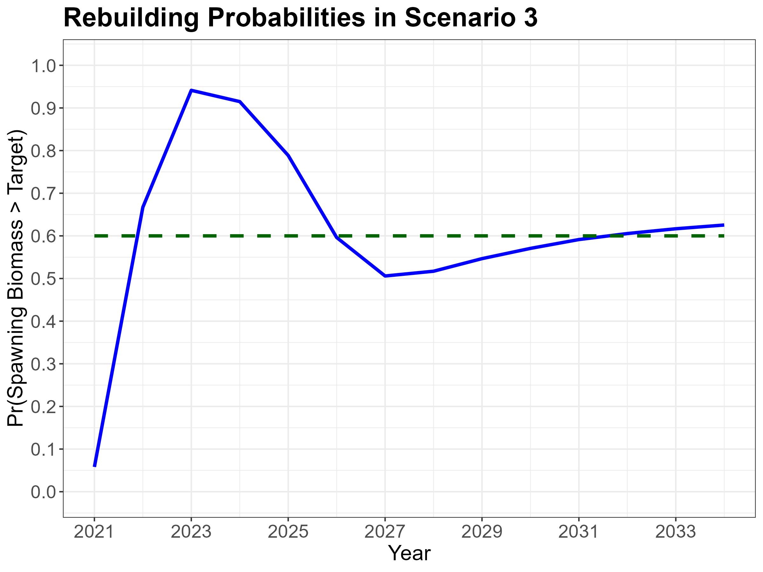

Slide 45
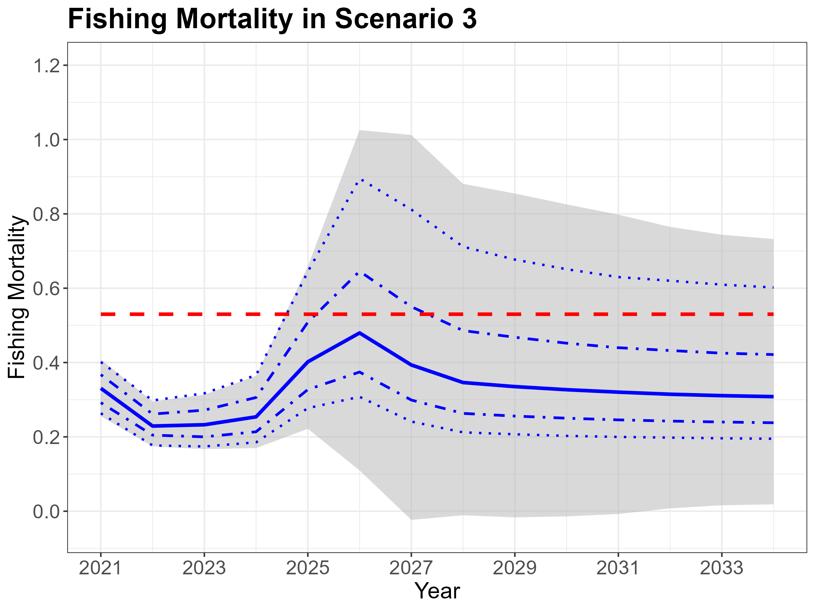

Slide 46
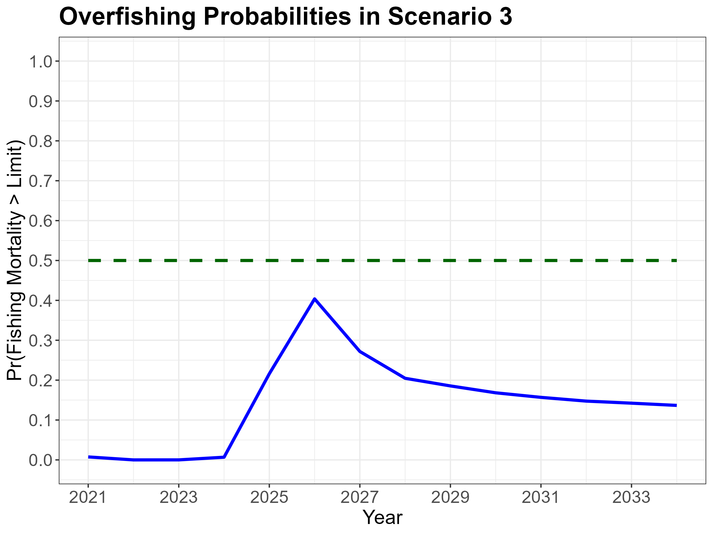

Slide 47
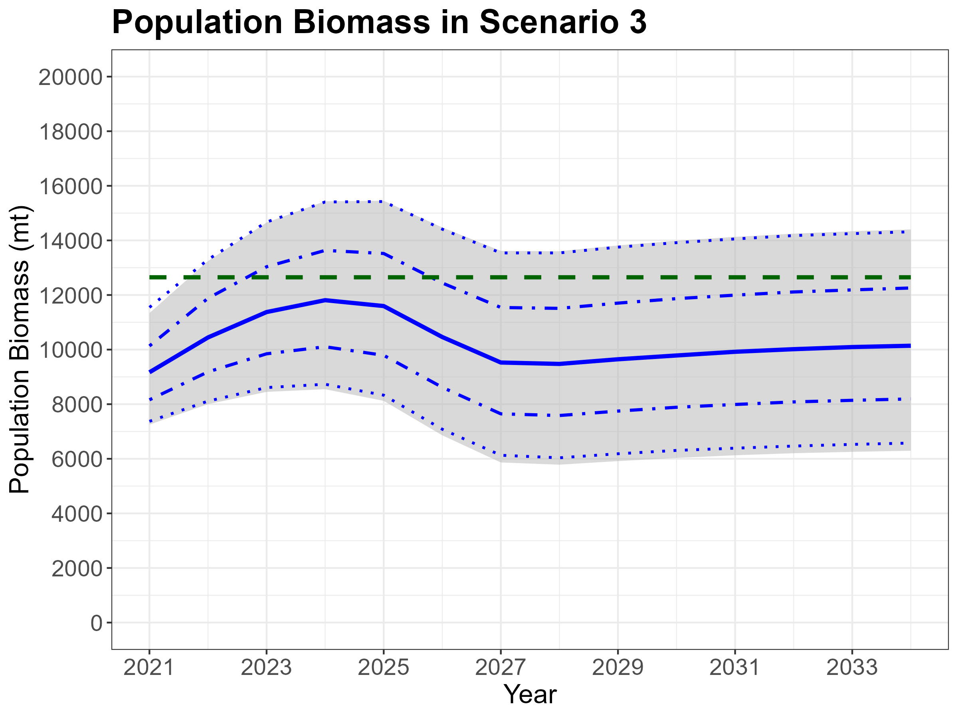

Slide 49
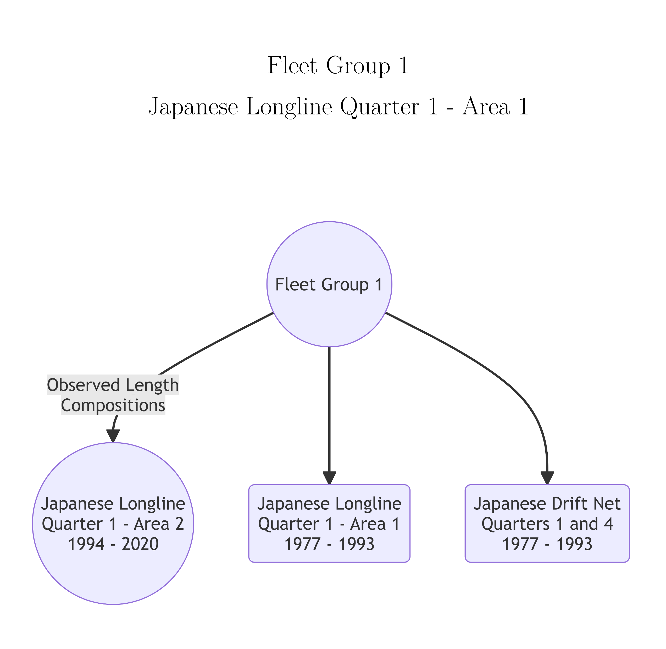
Fleet Groups with Identical Fishery Selectivity for Striped Marlin

Slide 50
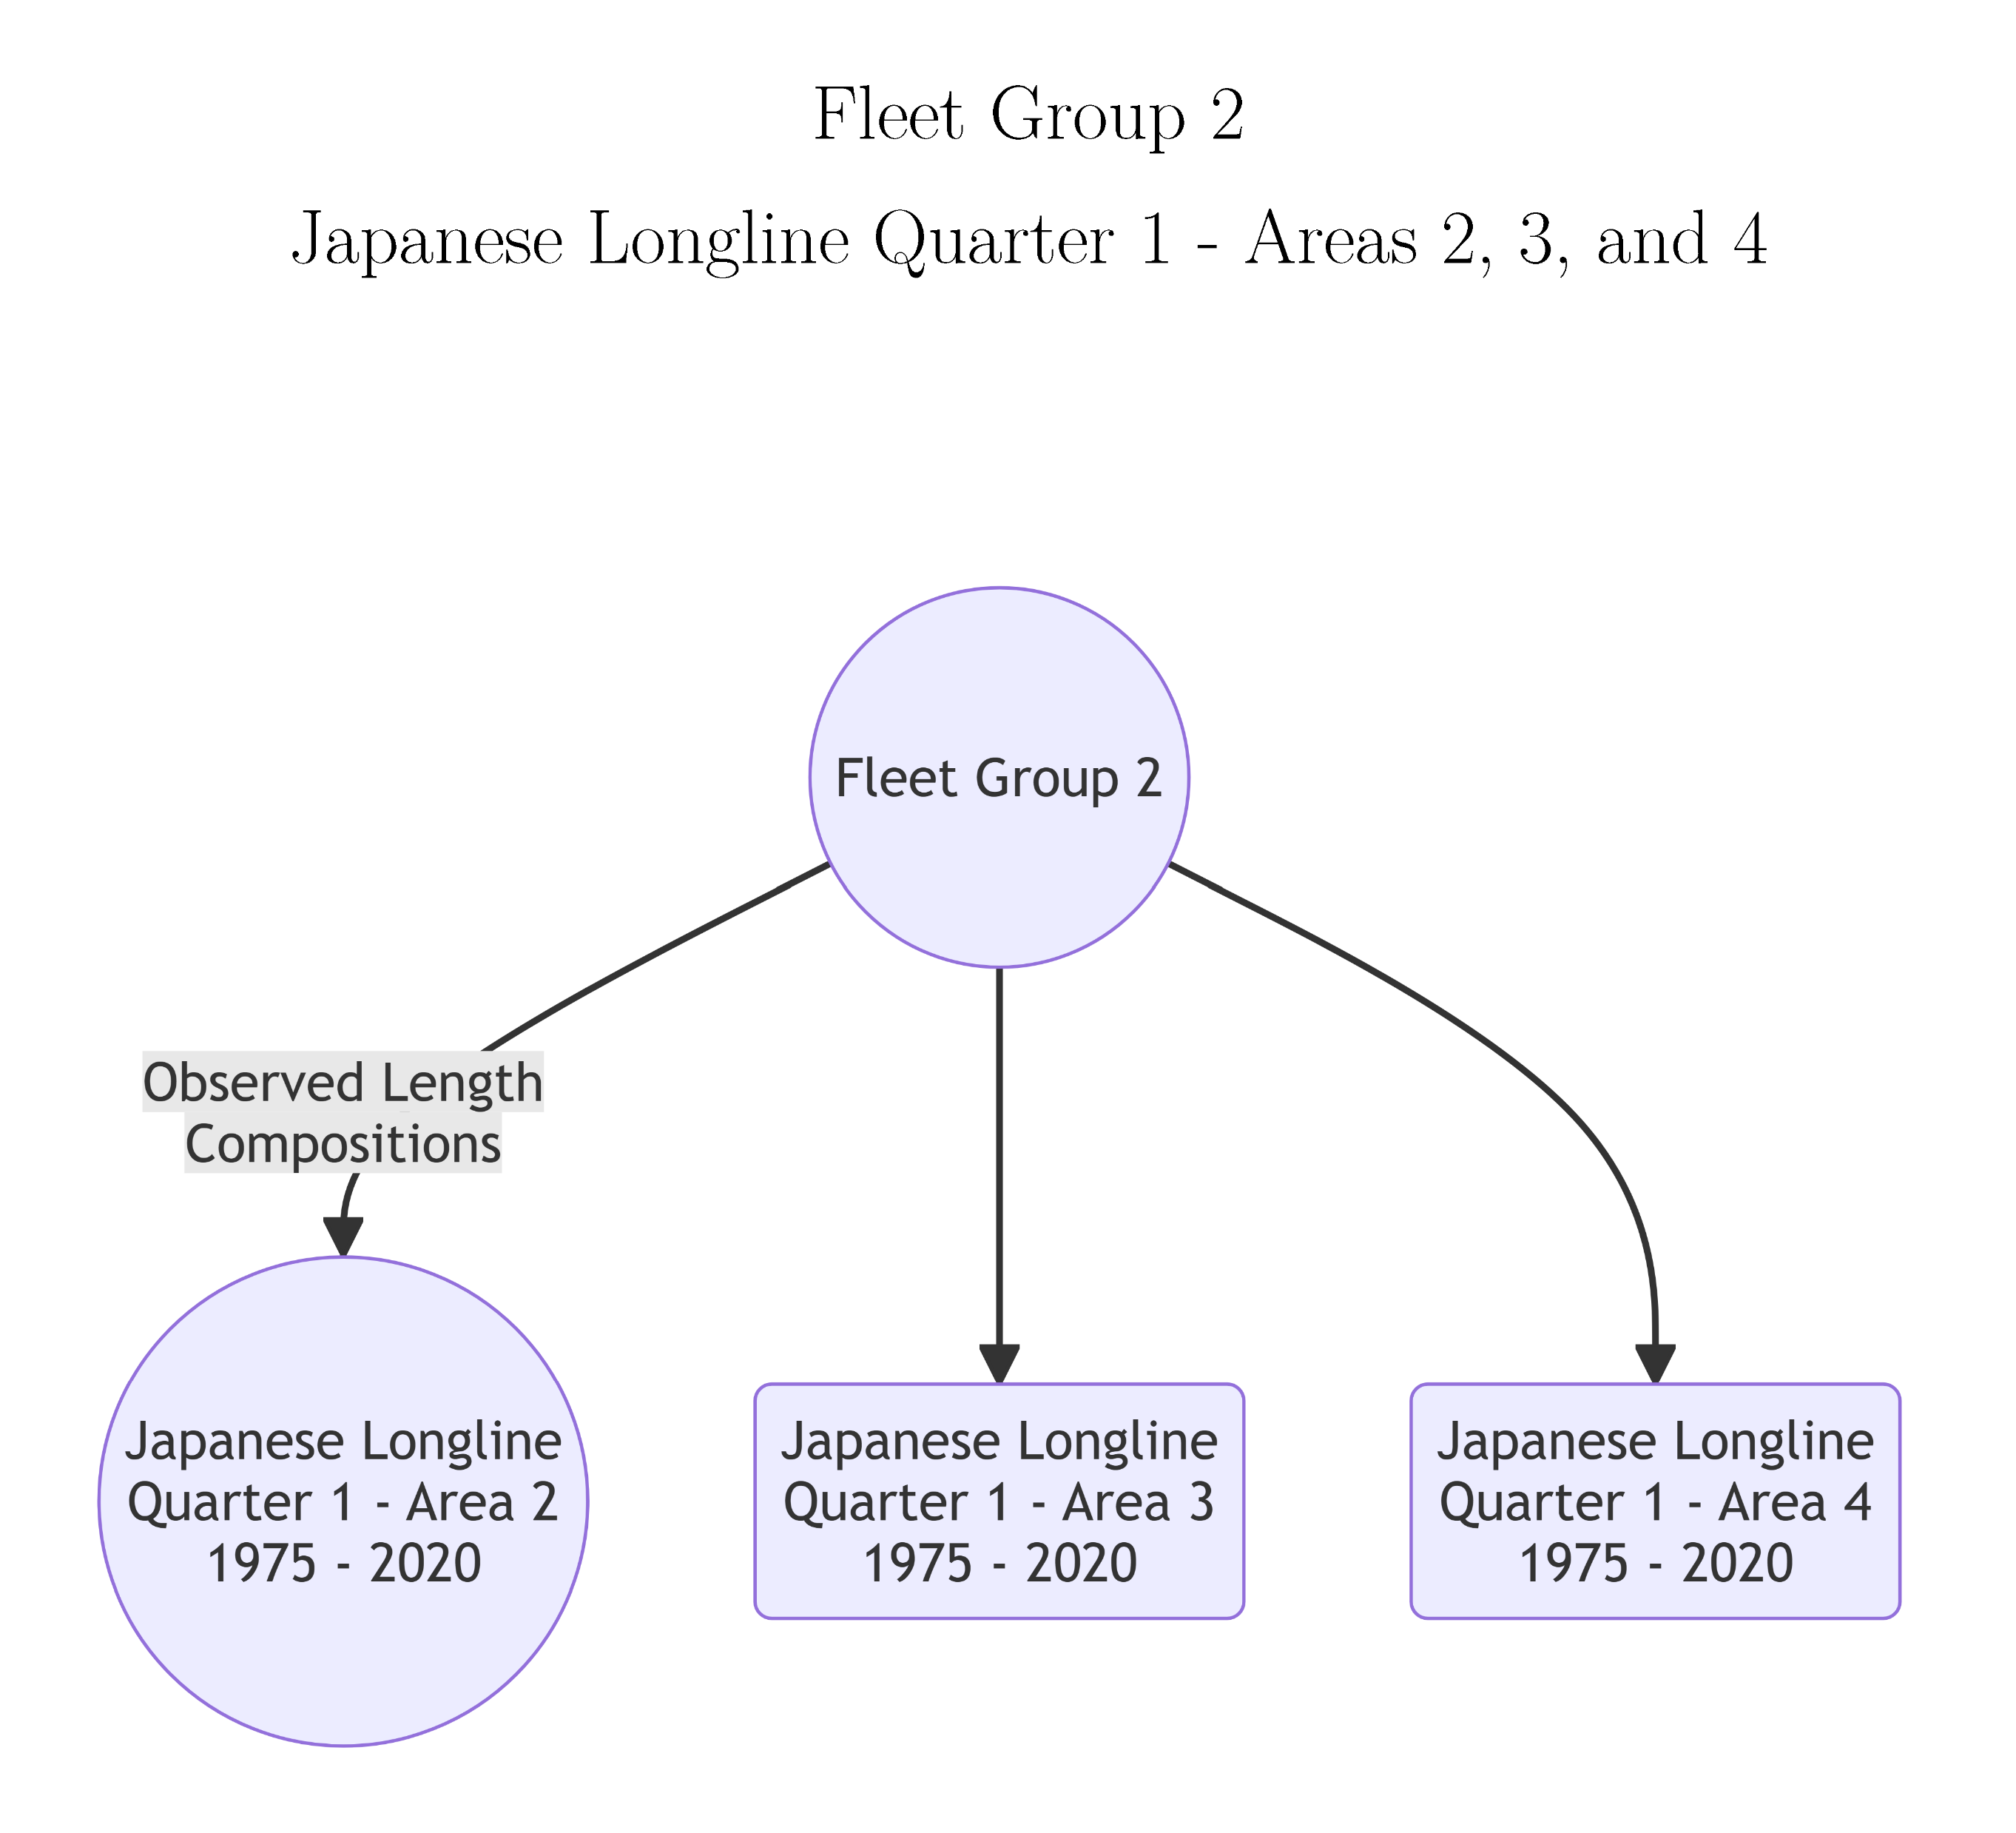
Fleet Groups with Identical Fishery Selectivity for Striped Marlin

Slide 51
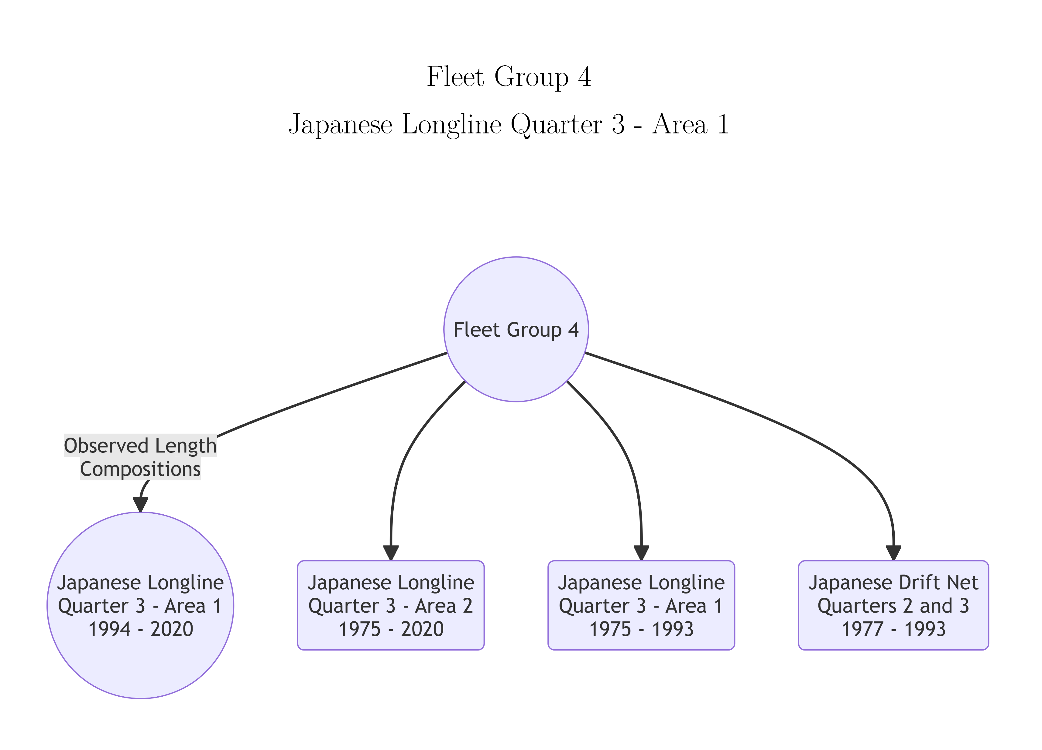
Fleet Groups with Identical Fishery Selectivity for Striped Marlin

Slide 52
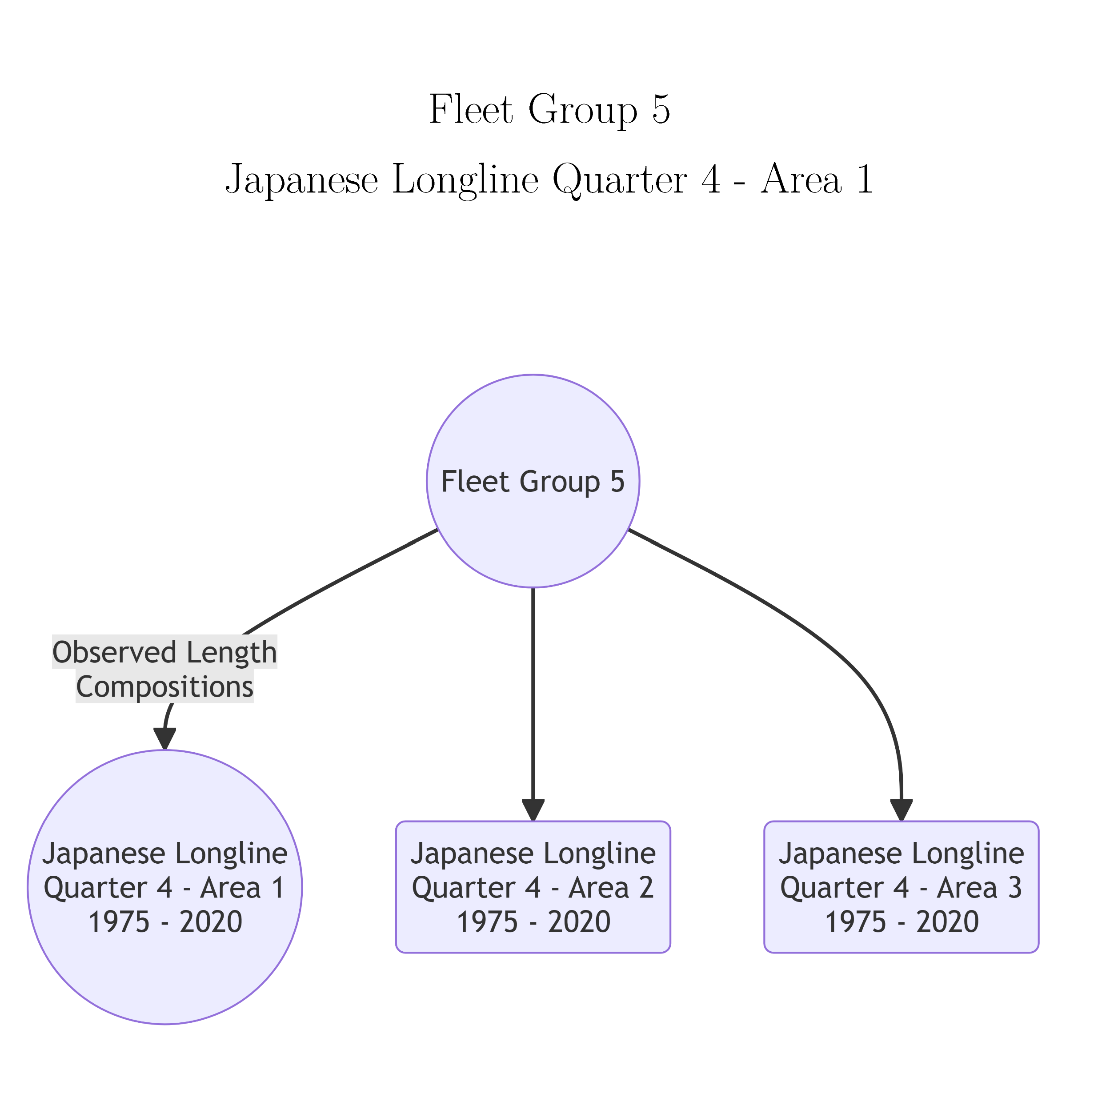
Fleet Groups with Identical Fishery Selectivity for Striped Marlin

Slide 53
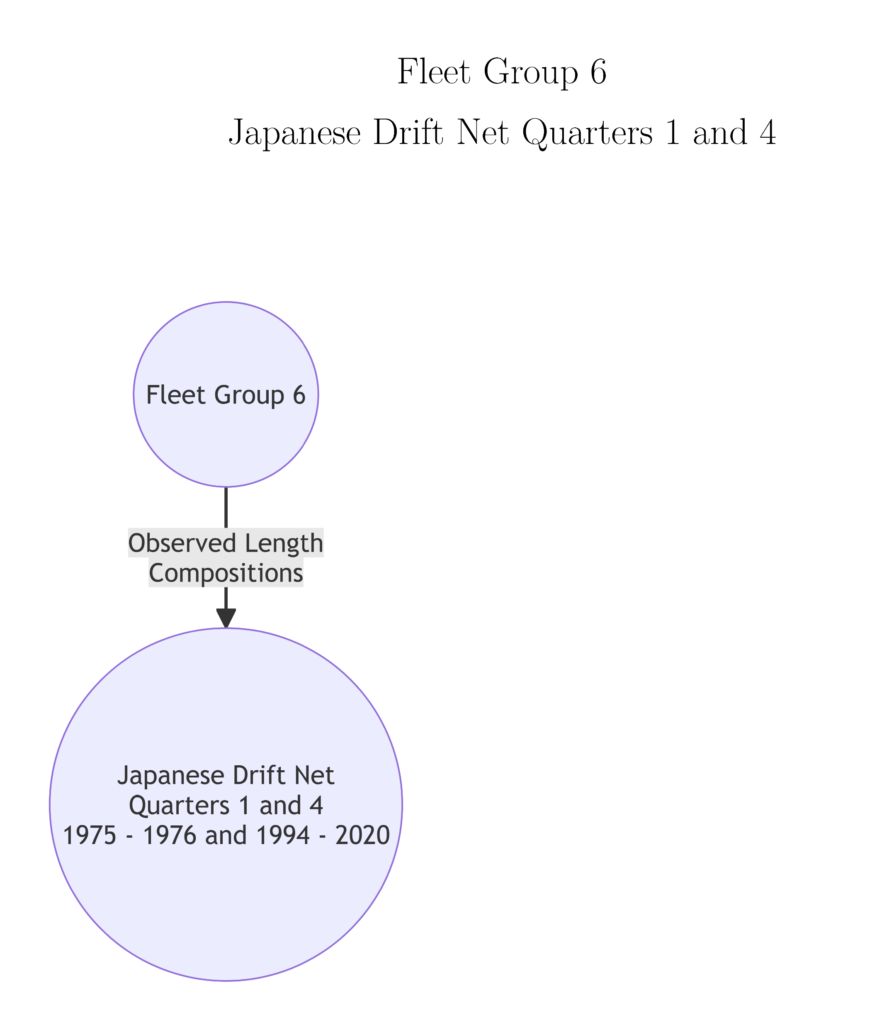
Fleet Groups with Identical Fishery Selectivity for Striped Marlin

Slide 54
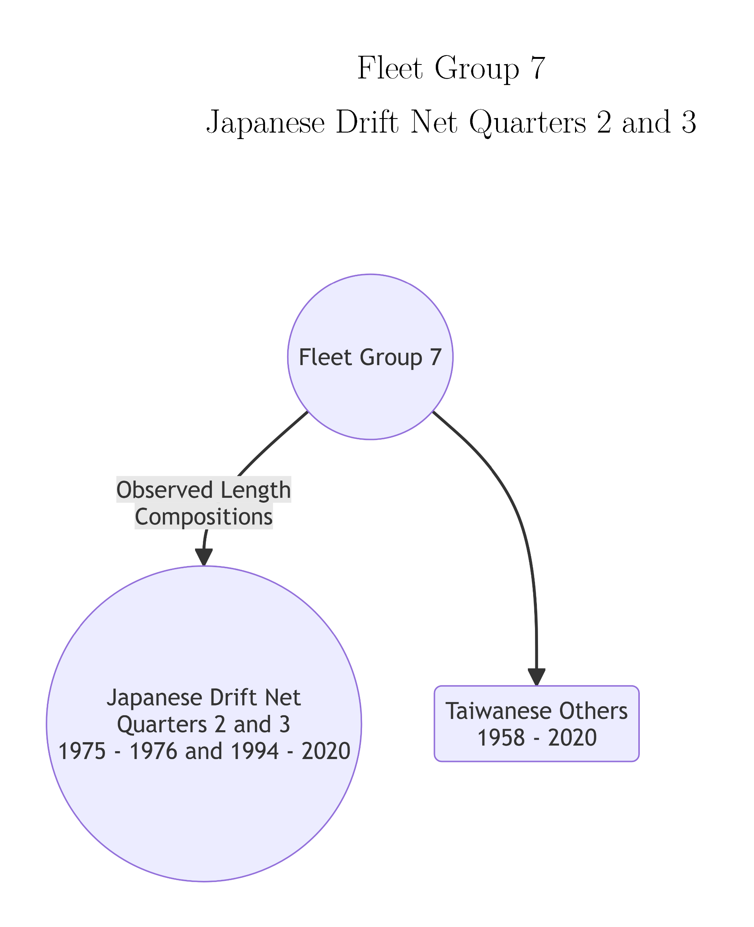
Fleet Groups with Identical Fishery Selectivity for Striped Marlin

Slide 55



Slide 56


